Slide 1
Perceptron Learning

Slide 2







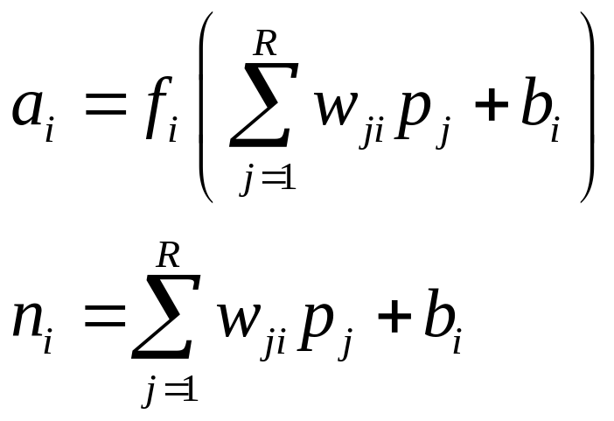














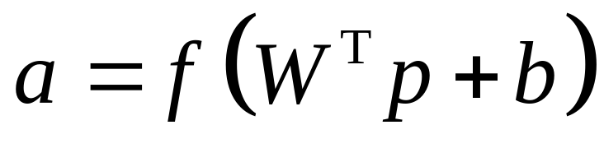



Perceptron
Math Model

Slide 3

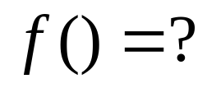





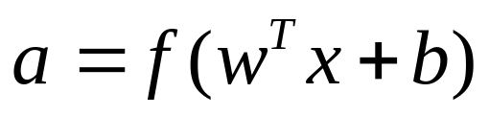
Perception Design
shape
texture
weight
Learning

Slide 4
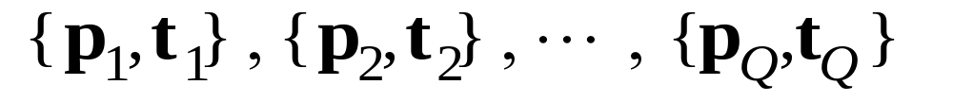
Learning Rules
target
input
• Supervised Learning
Network is provided with a set of examples
of proper network behavior (inputs/targets)

Slide 5
Learning Rules
• Semi-supervised Learning

Slide 6
Learning Rules
• Unsupervised Learning
Only network inputs are available to the learning
algorithm. Network learns to categorize (cluster)
the inputs.

Slide 7
Learning Rules
• Reinforcement Learning
Network is only provided with a grade, or score,
which indicates network performance
Agent
State
Reward
Action
Environment
Machine Learning, Tom M. Mitchell,1997

Slide 8
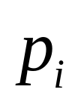

Learning Rules
target
input
Learning aim: adjusting connection weights
Perceptron

Slide 9

Learning Rules
target
input
Adjusting weights W

Slide 10
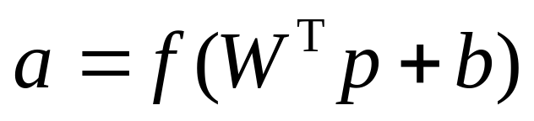
Learning Rules
target
input
Question : How to adjust W?

Slide 11
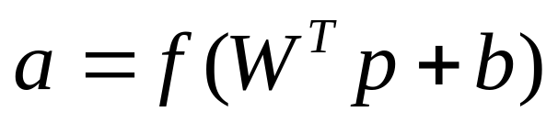
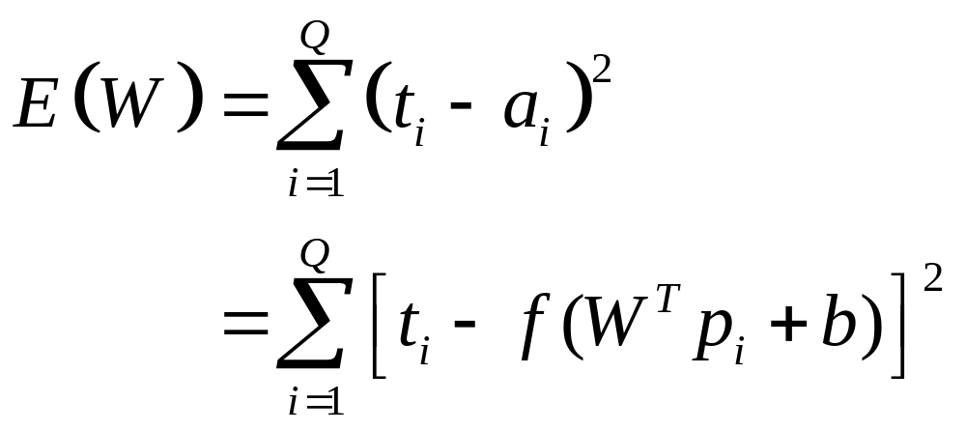
Learning Rules

Slide 12
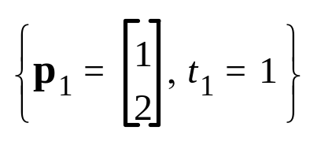
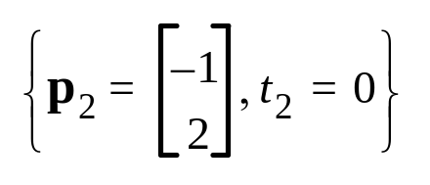
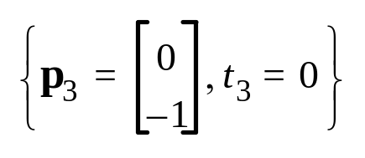
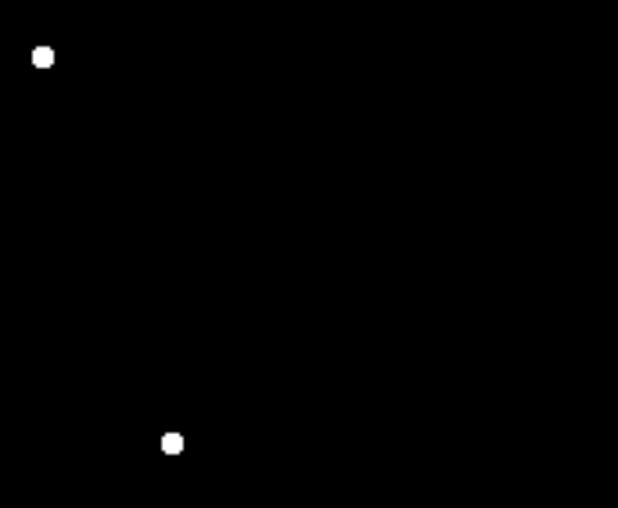
Learning Rule

Slide 13






Learning Rule
total 43 pages

Slide 14

Learning Rule
W

Slide 15


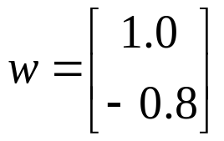


Starting Point
Random initial weight:

Slide 16
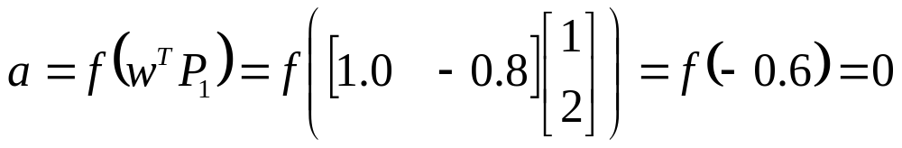
Starting Point
Random initial weight:
Present p₁ to the network:
Incorrect Classification.
total 43 pages

Slide 17


Adjusting W

Slide 18
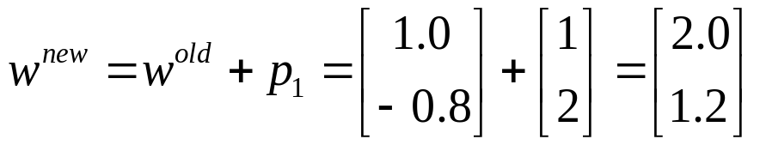
First Iteration
Learning Rule:

Slide 19
First iteration
Learning Rule:

Slide 20
First Iteration
Learning Rule:

Slide 21
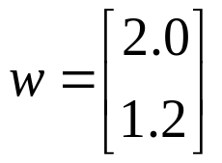

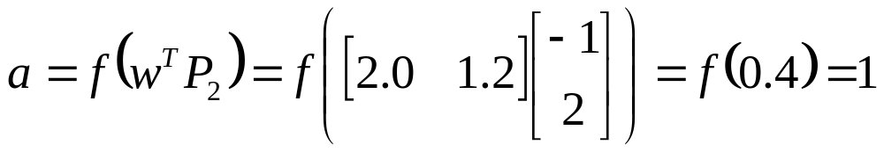
Checking
Incorrect Classification.

Slide 22
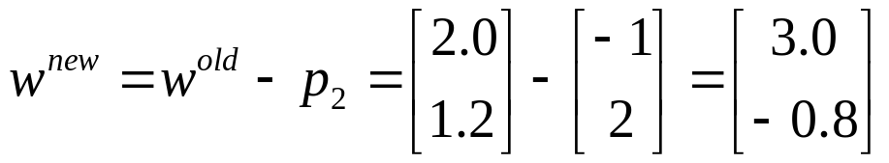


Second Iteration
Learning Rule:

Slide 23
Second Iteration
Learning Rule:

Slide 24
Second Iteration
Learning Rule:

Slide 25


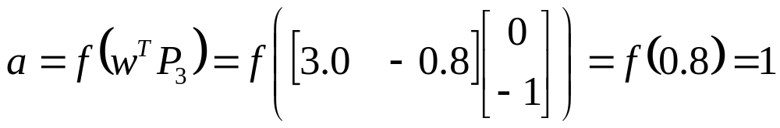
Checking
(Incorrect Classification)

Slide 26
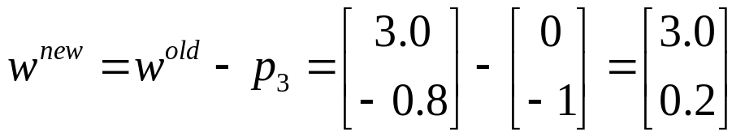
Third Iteration
Learning Rule:

Slide 27
Third Iteration
Learning Rule:

Slide 28

Algorithm Converged
Patterns are now correctly classified.
Learning Rule:

Slide 29
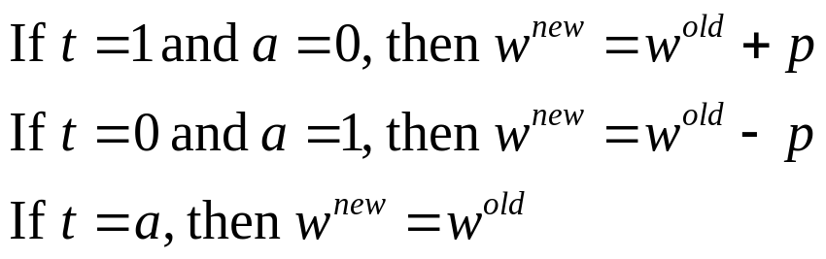
Unified Learning Rule
Learning Rule:

Slide 30
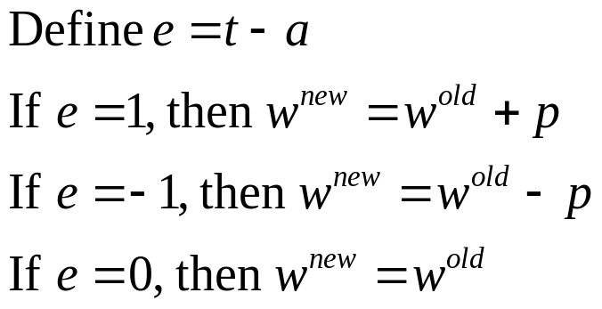
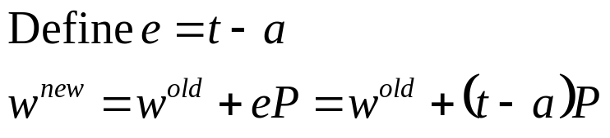
Unified Learning Rule
Learning Rule:
Learning Rule:
total 43 pages

Slide 31
Unified Learning Rule
Learning Rule:

Slide 32
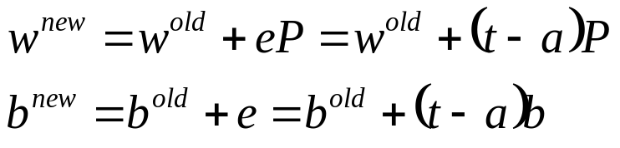
Unified Learning Rule
A bias is a
weight with
an input of 1.
Learning Rule:

Slide 33
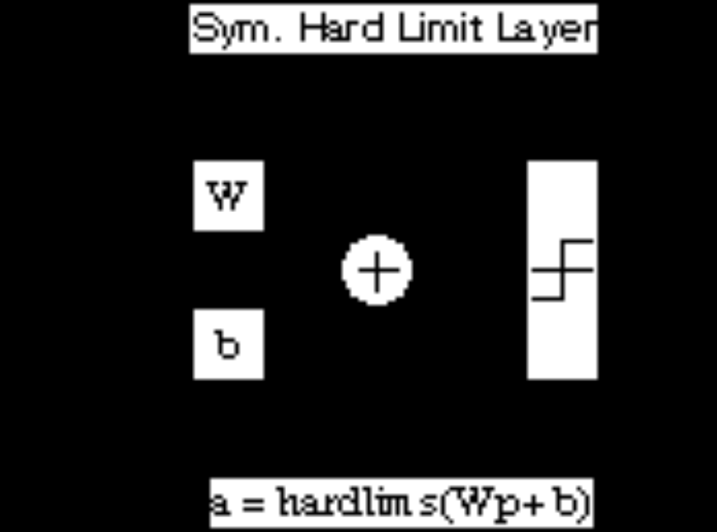
Perceptron

Slide 34
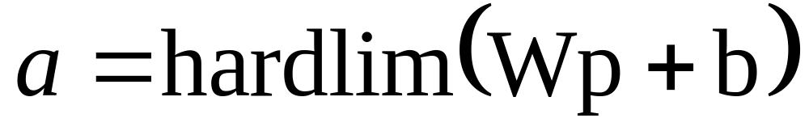


Multiple-Neuron Perceptrons
Learning Algorithm

Slide 35
Multiple-Neuron Perceptrons
Step one: Design the perceptron structure
Step two: Training the network by learning algorithm
Learning Algorithm
total 43 pages

Slide 36
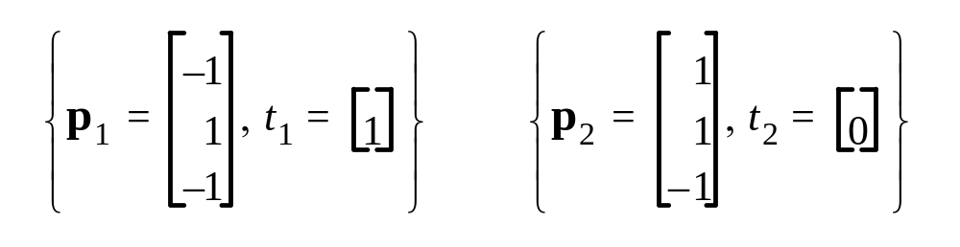
Apple/Banana Example
Training Set

Slide 37
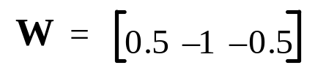

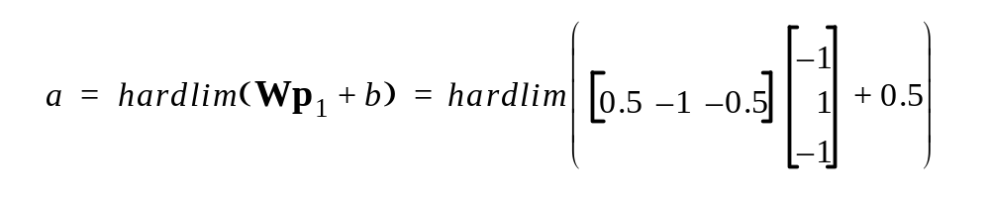

Apple/Banana Example
Initial Weights
First Iteration
e
=
t
–
a
=
1
–
0
=
1
1

Slide 38
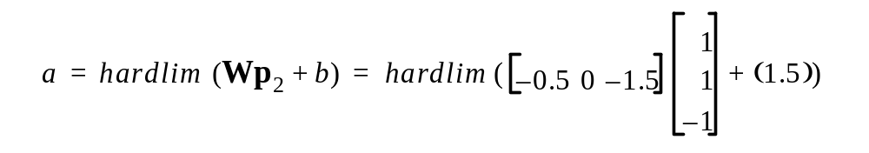



Second Iteration

Slide 39
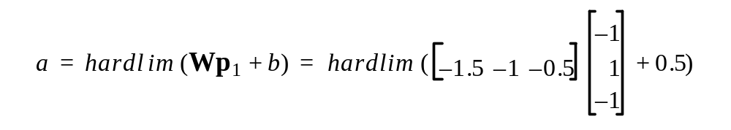

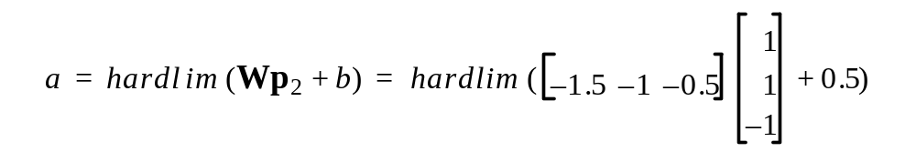
Check

Slide 40
Perceptron Ability
The perceptron rule will always converge to weights which accomplish the desired classification, assuming that such weights exist.

Slide 41

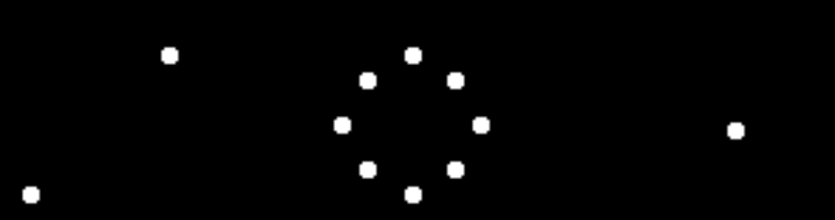
Perceptron limitation
Linear Decision Boundary
Linearly Inseparable Problems

Slide 42
Exercise 1
c1
c2
c3

Slide 43
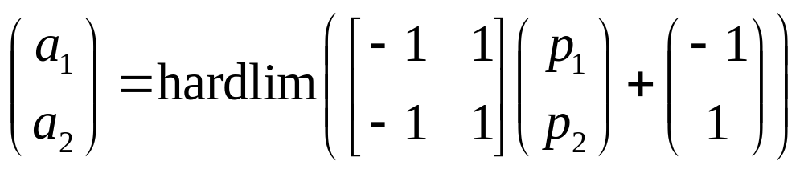
Solution to exercise 1

Slide 44
Exercise 2
c8
c1
c7
c2
c6
c3
c4
c5

Slide 45
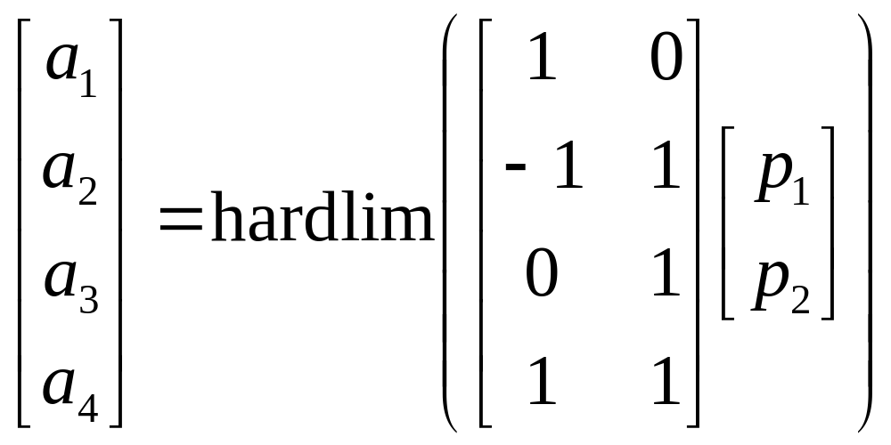
Solution to exercise 2

